Slide 1
Using SciVal to find “stretch” collaborators
Summer of Research
22 May 2024
Dr Hayley Cordingley

Slide 2
A case study
The “ask”
  Build consortium: getting useful search terms
The approach
  Using SciVal Topic Clusters and Topics to find…
    UoSx people
    Potential collaborators
The results
Where we’re at
(Postscript)
  (Other possible approaches - Research Areas)
    (Pre-populated by Elsevier)
    (Create your own)

Slide 3
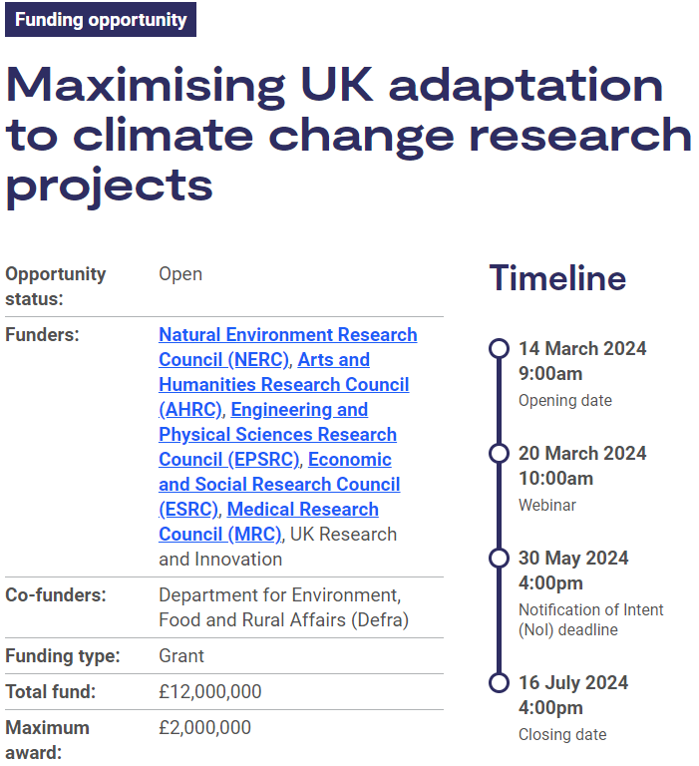
1: The “Ask”
Aim:
Deliver real-world solutions…
…to improve preparedness / resilience
…to climate change
…in UK
Focus:
Support dvpt of new collaborations & partnerships
Team:
Cross-sector
  Researchers; Policy makers; Practitioners; Industry; Public engagement professionals; Wider civil society
Transdisciplinary
  As broad as possible; NERC +≥1 other UKRI RC
UK-based partners
  International OK, but no £ and not lead
  (Met Office assistance a given if needed)
https://www.ukri.org/opportunity/maximising-uk-adaptation-to-climate-change-research-projects/

Slide 4
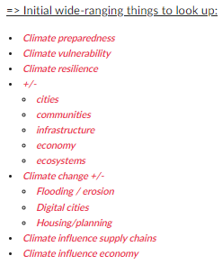
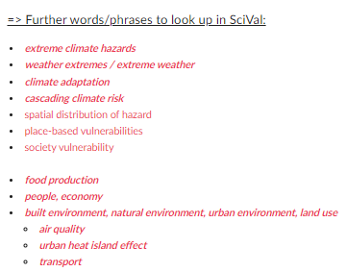
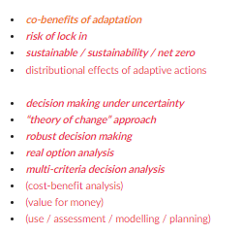
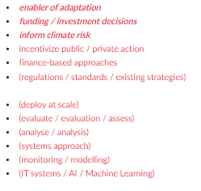
What need to search for?
Research Areas:
Adaption to climate change - in the UK
4 Research Themes:
Societies exposure and vulnerability to extreme climate hazards
Adaptation Solutions
Future resilience & decision making
Enablers of adaptation

Slide 5
What need to search for?
Research Areas:
Adaption to climate change - in the UK
4 Research Themes:
Societies exposure and vulnerability to extreme climate hazards
Adaptation Solutions
Future resilience & decision making
Enablers of adaptation
“Co-design” with Stakeholders
Cross-sector

Slide 6
A case study
The “ask”
The approach
The results
Where we’re at
(Postscript)

Slide 7
2: The Approach
Use SciVal Topics / Topic Clusters (T & TCs)
UoSx as an Entity:
  Find relevant Topic Clusters (TC) & Topics (T) UoSx publish in then…
Topics as an Entity:
  …Identify UoSx authors
  …Identify which other institutions (in UK) also publishing in the TC / T
  …(Top 100 Corporate, Gvt, Medical, Other - WW/UK)
Create Publication set, & use as an Entity:
  …Identify UoSx collaborating institutions
  …(Export publication sets from UoSx)

Slide 8
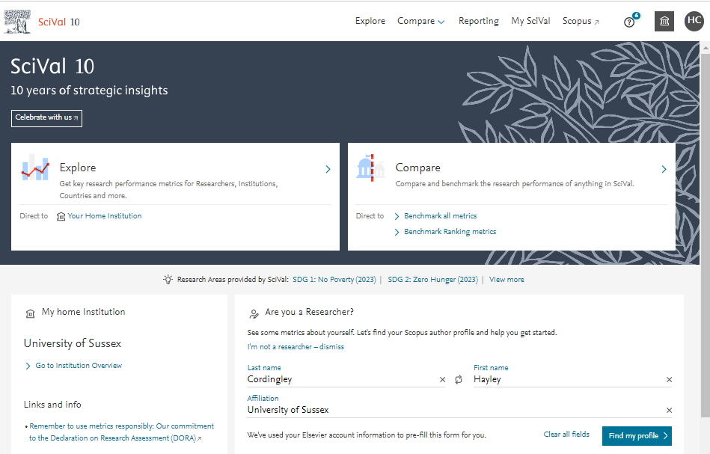
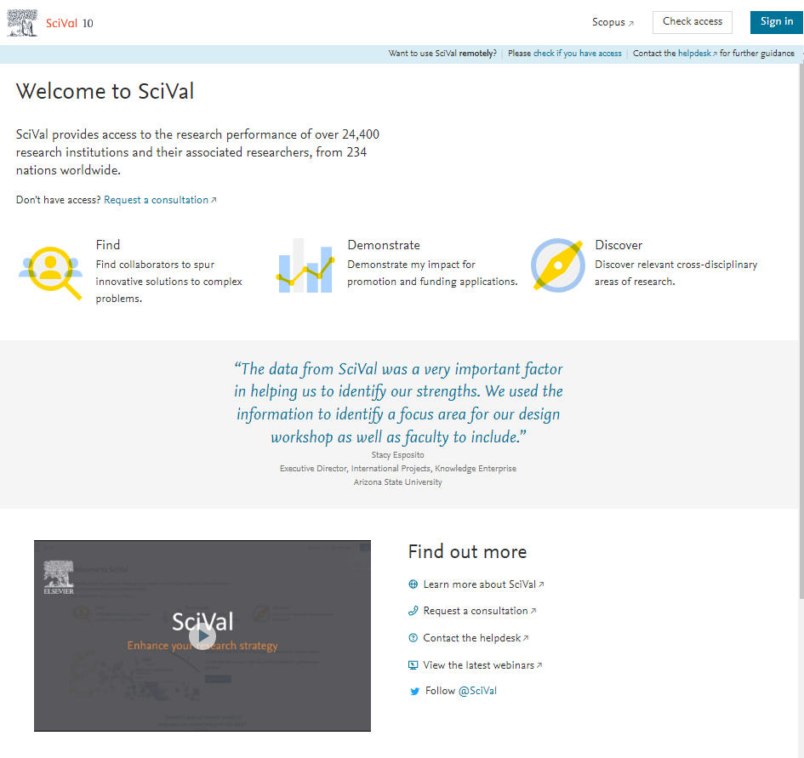
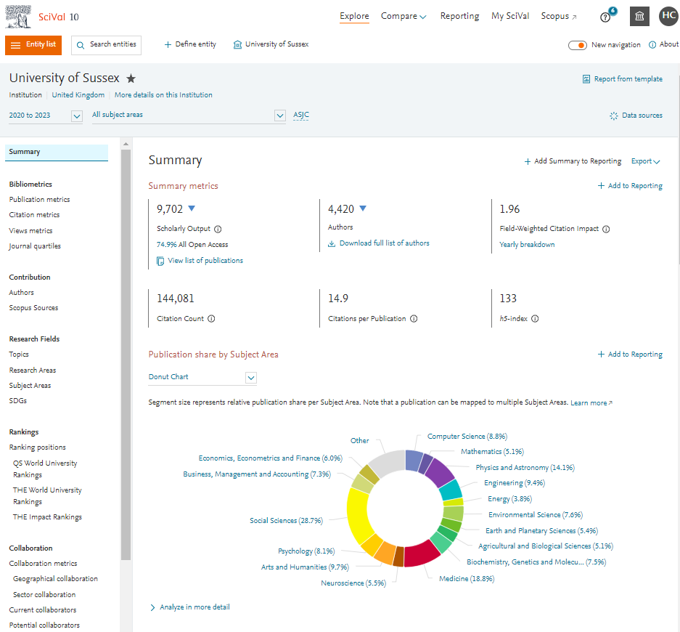
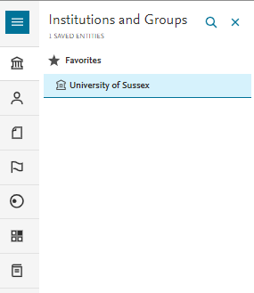
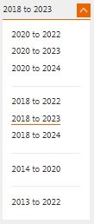
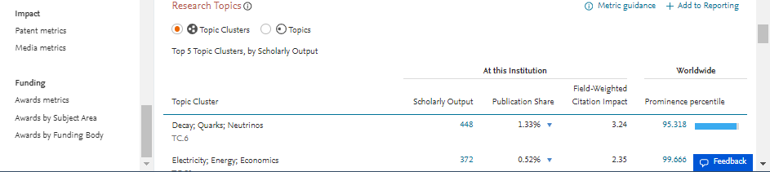
SciVal: Getting started (new look)
https://www.scival.com/landing

Slide 9
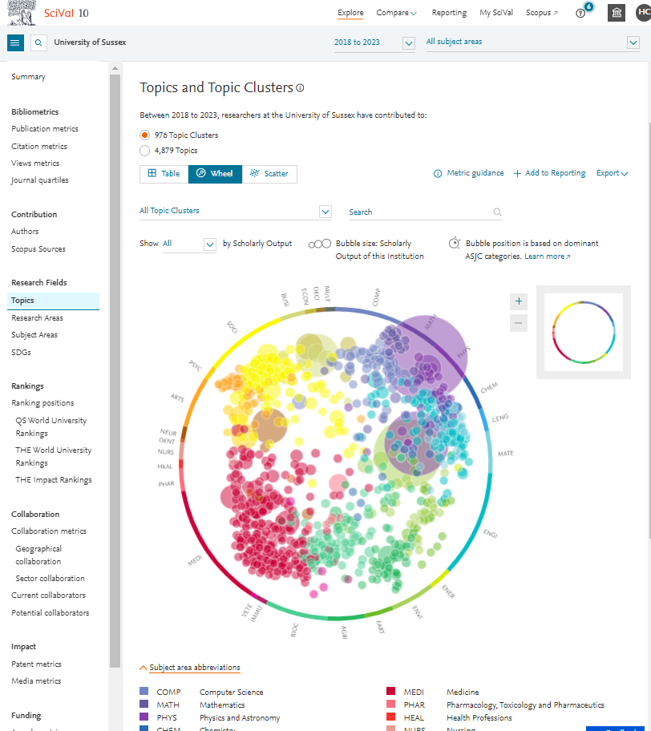
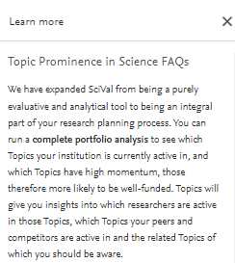
SciVal: Getting started (new look)
https://www.scival.com/landing
https://service.elsevier.com/app/answers/detail/a_id/28428/supporthub/scival/

Slide 10
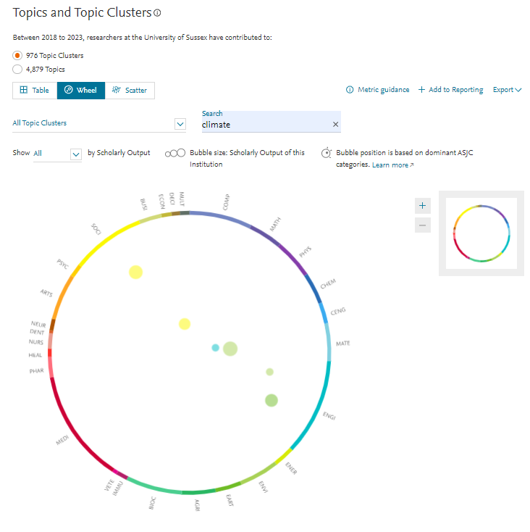
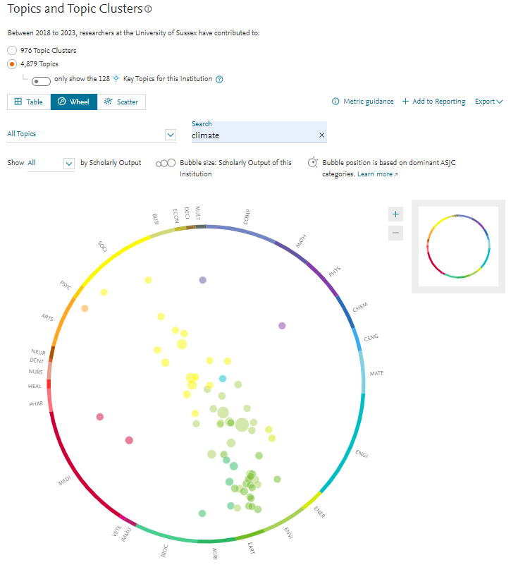
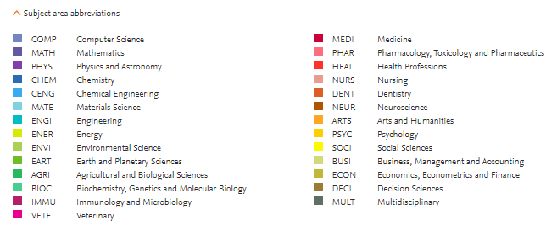
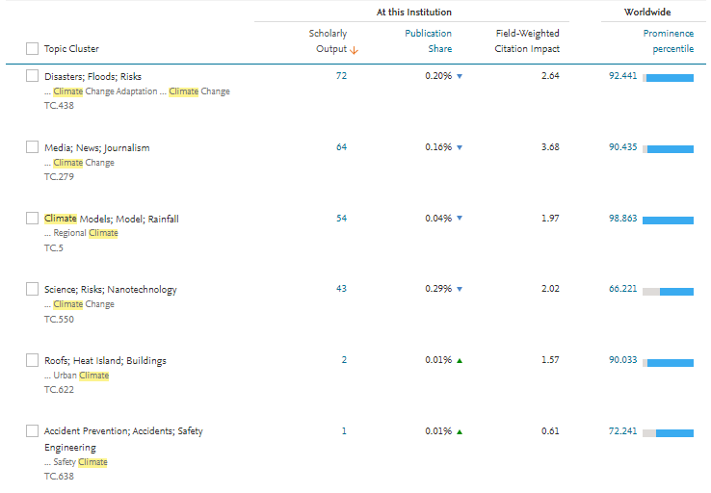
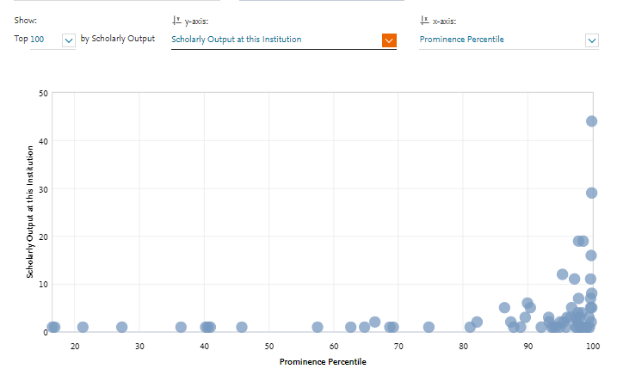
Searching for useful TCs & Ts @ UoSx
6 search terms =>6 TC & 67 T
Export to Excel

Slide 11
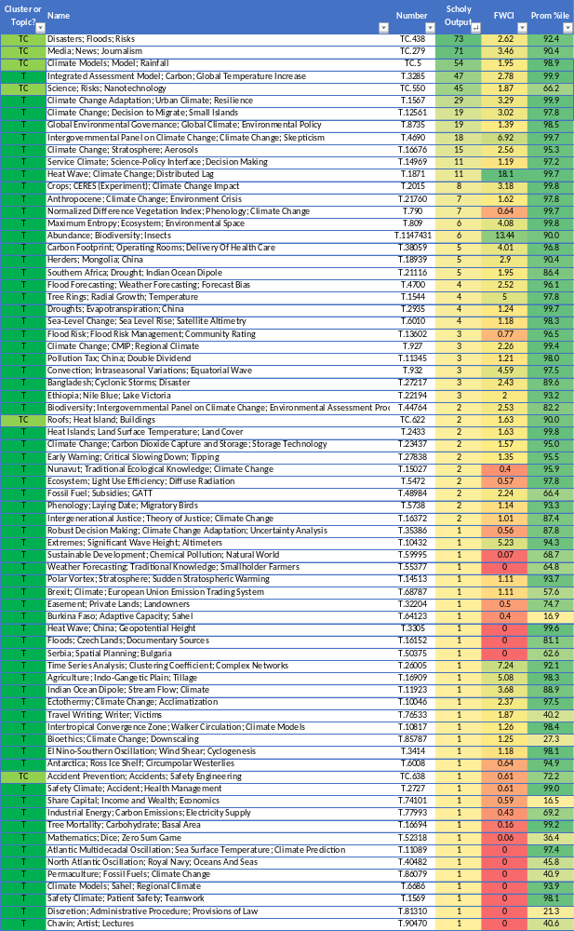
Searching for useful TCs & Ts @ UoSx
6 search terms =>6 TC & 67 T
Export to Excel

Slide 12
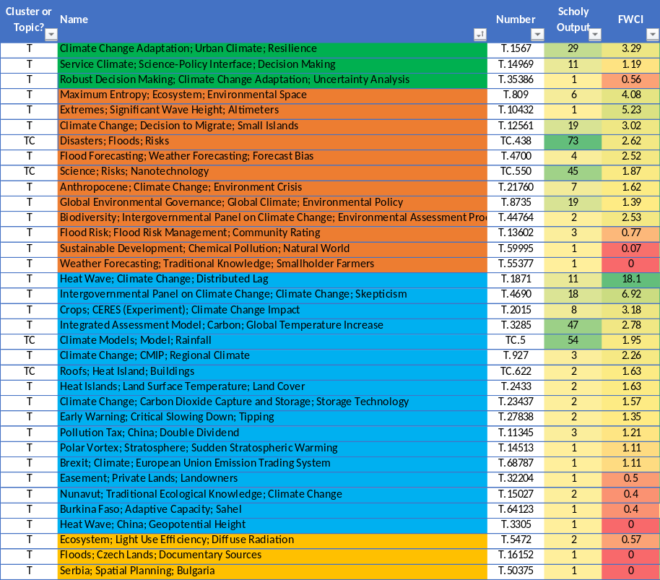
Refine down - part 1 (73 => 35)
T | Time Series Analysis; Clustering Coefficient; Complex Networks | T.26005 | 1 | 7.24
T | Agriculture; Indo-Gangetic Plain; Tillage | T.16909 | 1 | 5.08
T | Convection; Intraseasonal Variations; Equatorial Wave | T.932 | 3 | 4.59
T | Indian Ocean Dipole; Stream Flow; Climate | T.11923 | 1 | 3.68
T | Abundance; Biodiversity; Insects | T.1147431 | 6 | 13.44
T | Bangladesh; Cyclonic Storms; Disaster | T.27217 | 3 | 2.43
T | Ectothermy; Climate Change; Acclimatization | T.10046 | 1 | 2.37
T | Fossil Fuel; Subsidies; GATT | T.48984 | 2 | 2.24
T | Ethiopia; Nile Blue; Lake Victoria | T.22194 | 3 | 2
T | Tree Rings; Radial Growth; Temperature | T.1544 | 4 | 5
T | Carbon Footprint; Operating Rooms; Delivery Of Health Care | T.38059 | 5 | 4.01
TC | Media; News; Journalism | TC.279 | 71 | 3.46
T | Travel Writing; Writer; Victims | T.76533 | 1 | 1.87
T | Herders; Mongolia; China | T.18939 | 5 | 2.9
T | Climate Change; Stratosphere; Aerosols | T.16676 | 15 | 2.56
T | Intertropical Convergence Zone; Walker Circulation; Climate Models | T.10817 | 1 | 1.26
T | Bioethics; Climate Change; Downscaling | T.85787 | 1 | 1.25
T | Southern Africa; Drought; Indian Ocean Dipole | T.21116 | 5 | 1.95
T | Droughts; Evapotranspiration; China | T.2935 | 4 | 1.24
T | Sea-Level Change; Sea Level Rise; Satellite Altimetry | T.6010 | 4 | 1.18
T | El Nino-Southern Oscillation; Wind Shear; Cyclogenesis | T.3414 | 1 | 1.18
T | Phenology; Laying Date; Migratory Birds | T.5738 | 2 | 1.14
T | Intergenerational Justice; Theory of Justice; Climate Change | T.16372 | 2 | 1.01
T | Normalized Difference Vegetation Index; Phenology; Climate Change | T.790 | 7 | 0.64
T | Antarctica; Ross Ice Shelf; Circumpolar Westerlies | T.6008 | 1 | 0.64
TC | Accident Prevention; Accidents; Safety Engineering | TC.638 | 1 | 0.61
T | Safety Climate; Accident; Health Management | T.2727 | 1 | 0.61
T | Share Capital; Income and Wealth; Economics | T.74101 | 1 | 0.59
T | Industrial Energy; Carbon Emissions; Electricity Supply | T.77993 | 1 | 0.43
T | Tree Mortality; Carbohydrate; Basal Area | T.16694 | 1 | 0.16
T | Mathematics; Dice; Zero Sum Game | T.52318 | 1 | 0.06
T | Atlantic Multidecadal Oscillation; Sea Surface Temperature; Climate Prediction | T.11089 | 1 | 0
T | North Atlantic Oscillation; Royal Navy; Oceans And Seas | T.40482 | 1 | 0
T | Permaculture; Fossil Fuels; Climate Change | T.86079 | 1 | 0
T | Climate Models; Sahel; Regional Climate | T.6686 | 1 | 0
T | Safety Climate; Patient Safety; Teamwork | T.1569 | 1 | 0
T | Discretion; Administrative Procedure; Provisions of Law | T.81310 | 1 | 0
T | Chavín; Artist; Lectures | T.90470 | 1 | 0
1: Contain a search term in T/TC name => Orange
2: Exact hit for key phrase => Deep Green
3: Review orange & if not sure => Gold
4: Read titles of all others & if think relevant => Aqua

Slide 13
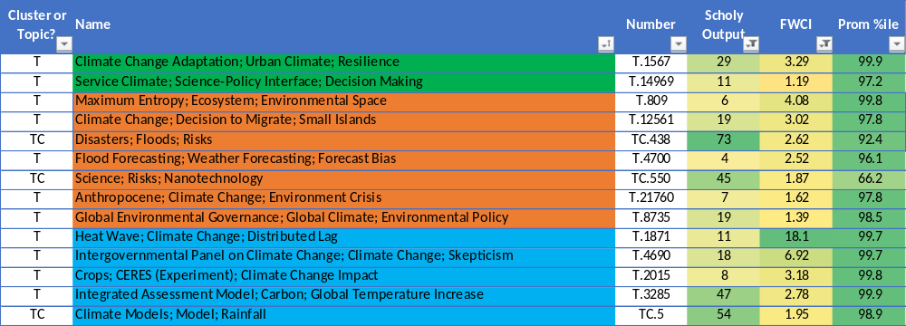
Refine down – part 2 (35 => 14)
1: # publications for period ≥ 4
2: FWCI ≥ 1

Slide 14
2: The Approach
Use SciVal Topics / Topic Clusters (T & TCs)
UoSx as an Entity:
  Find relevant Topic Clusters (TC) & Topics (T) UoSx publish in then…
Topics as an Entity:
  …Identify UoSx authors
  …Identify which other institutions (in UK) also publishing in the TC / T
  …(Top 100 Corporate, Gvt, Medical, Other - WW/UK)
Create Publication set, & use as an Entity:
  …Identify UoSx collaborating institutions
  …(Export publication sets from UoSx)

Slide 15
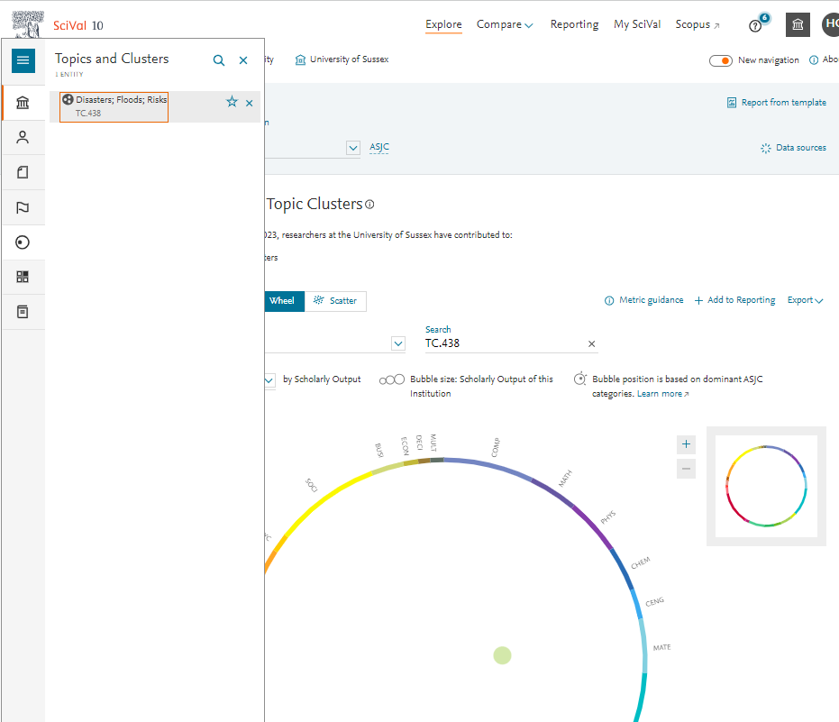
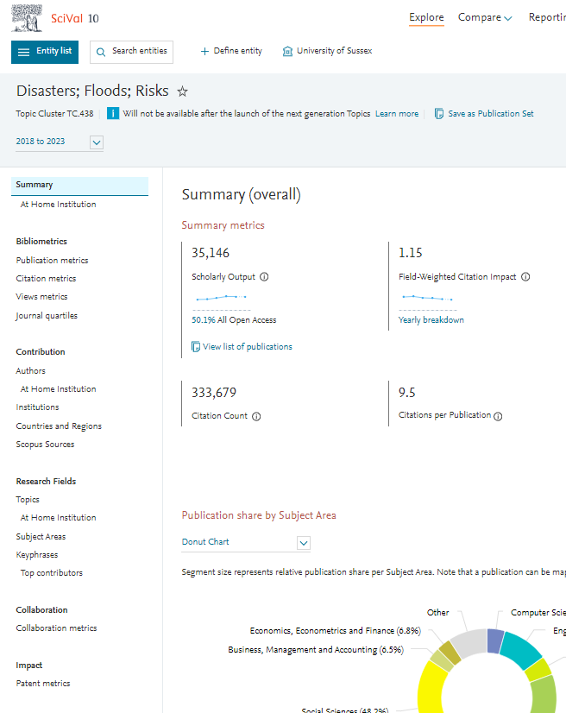
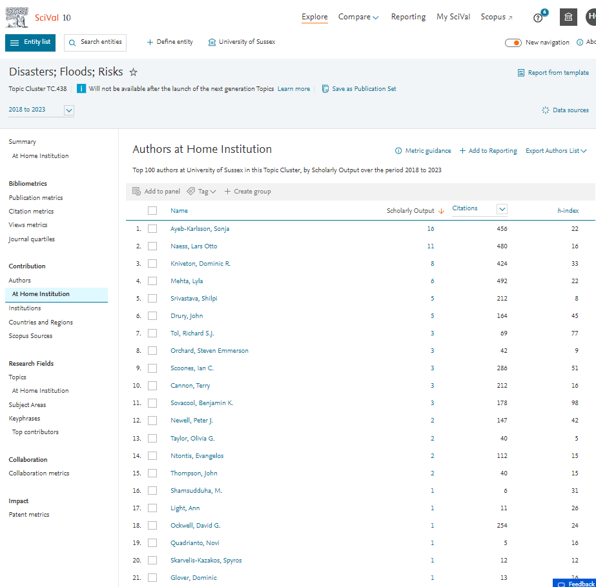
Identifying UoSx Authors:
TC /T as entity

Slide 16
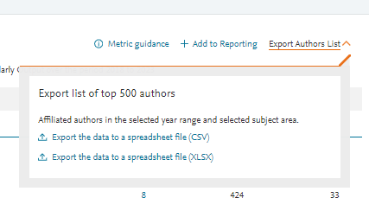
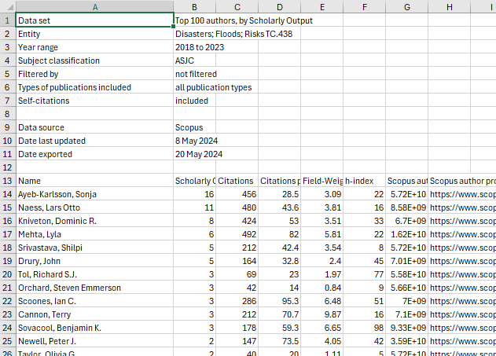
Identifying UoSx Authors:
TC /T as entity

Slide 17
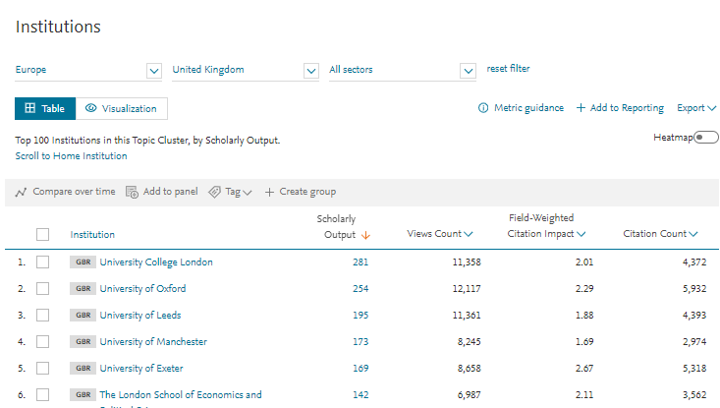
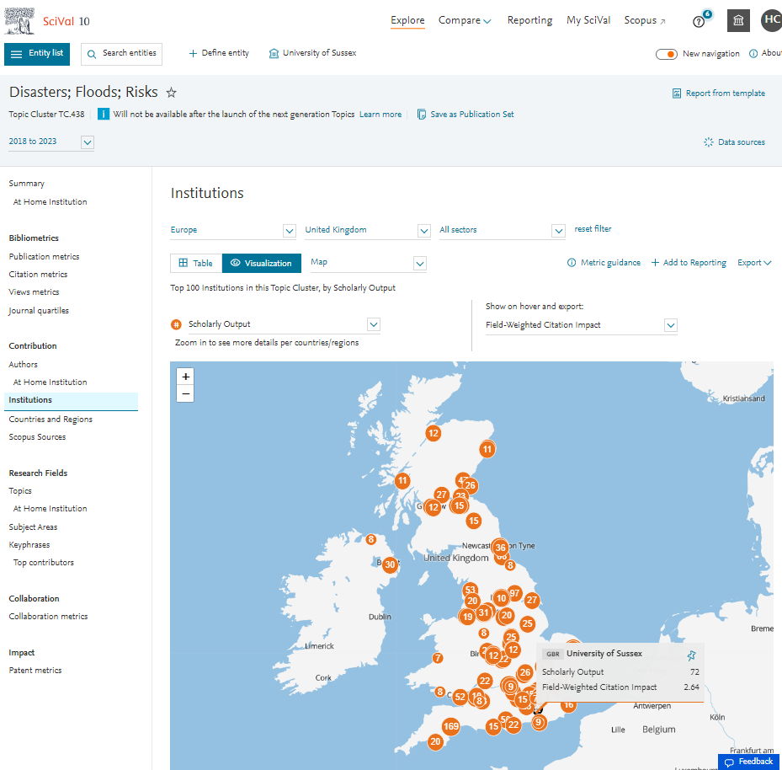
Identifying other UK institutions:
TC /T as entity

Slide 18
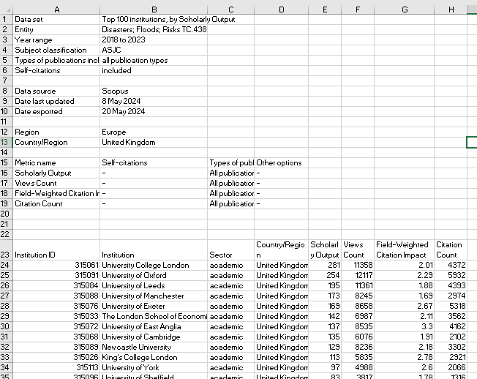
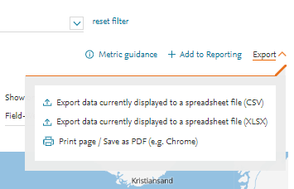
Identifying other UK institutions:
TC /T as entity

Slide 19
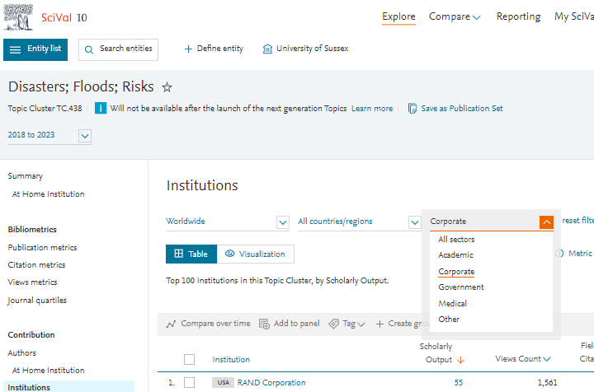
Identifying other sector institutions UK / WW:
TC /T as entity

Slide 20
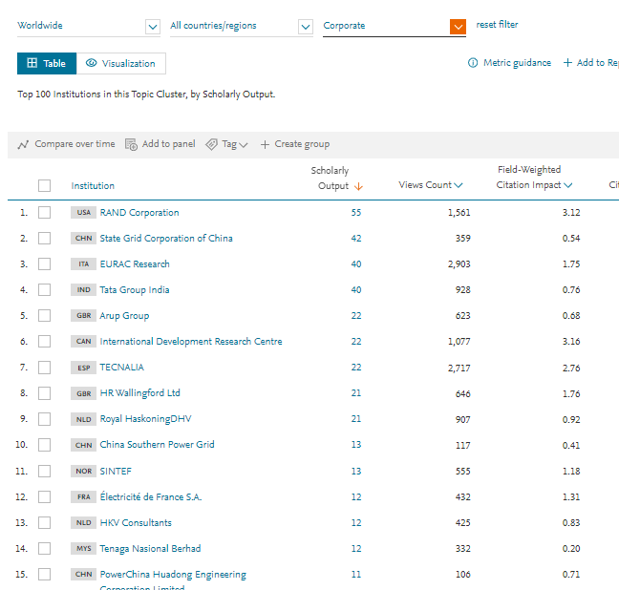
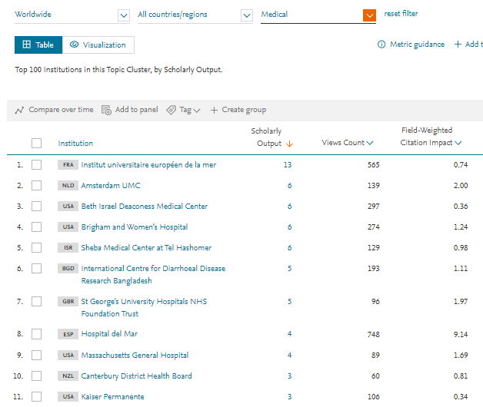
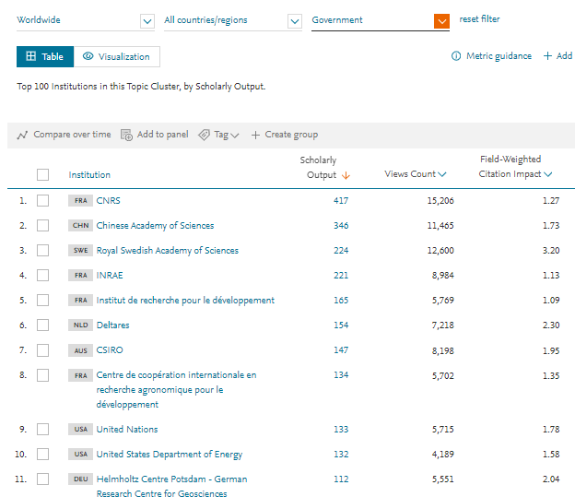
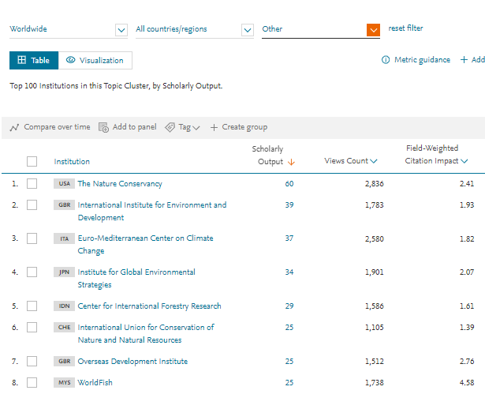
Identifying other WW institutions:
TC /T as entity

Slide 21
2: The Approach
Use SciVal Topics / Topic Clusters (T & TCs)
UoSx as an Entity:
  Find relevant Topic Clusters (TC) & Topics (T) UoSx publish in then…
Topics as an Entity:
  …Identify UoSx authors
  …Identify which other institutions (in UK) also publishing in the TC / T
  …(Top 100 Corporate, Gvt, Medical, Other - WW/UK)
Create Publication set, & use as an Entity:
  …Identify UoSx collaborating institutions
  …(Export publication sets from UoSx)

Slide 22
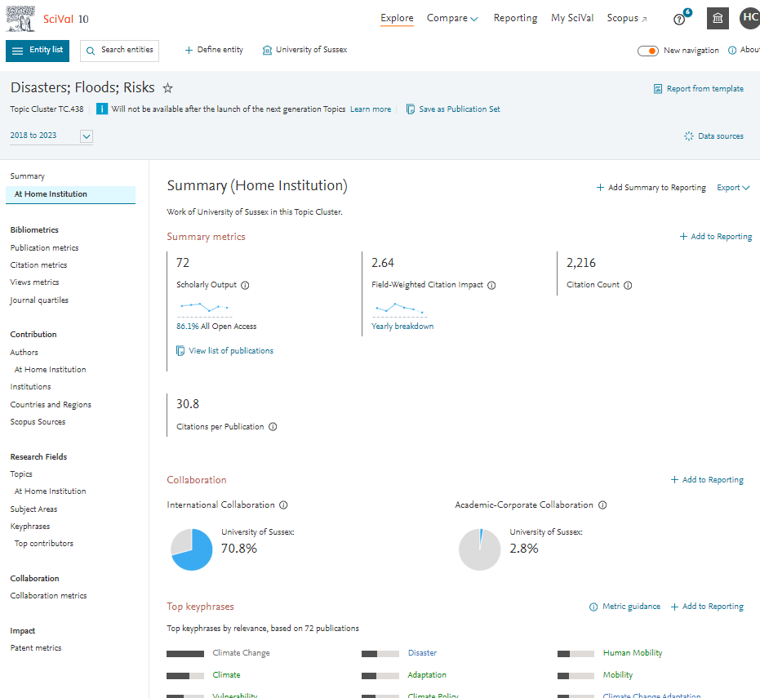
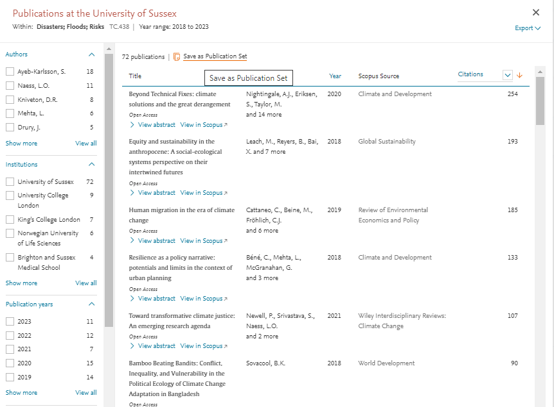
UoSx collaborating institutions:
Publication set as entity - step 1

Slide 23
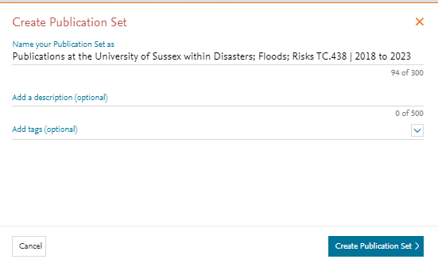
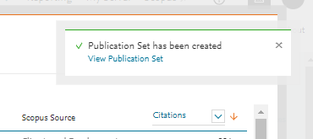
UoSx collaborating institutions:
Publication set as entity - step 1

Slide 24
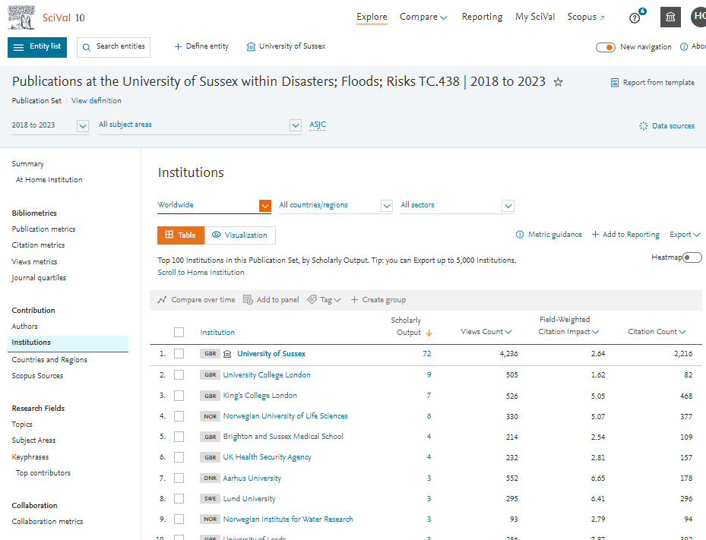
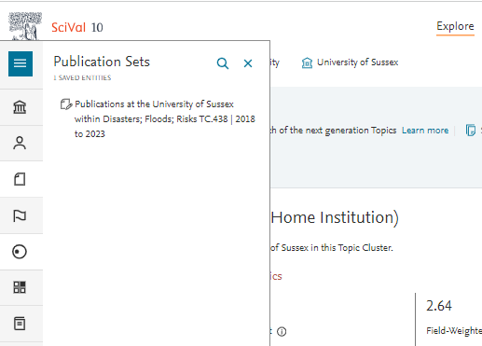
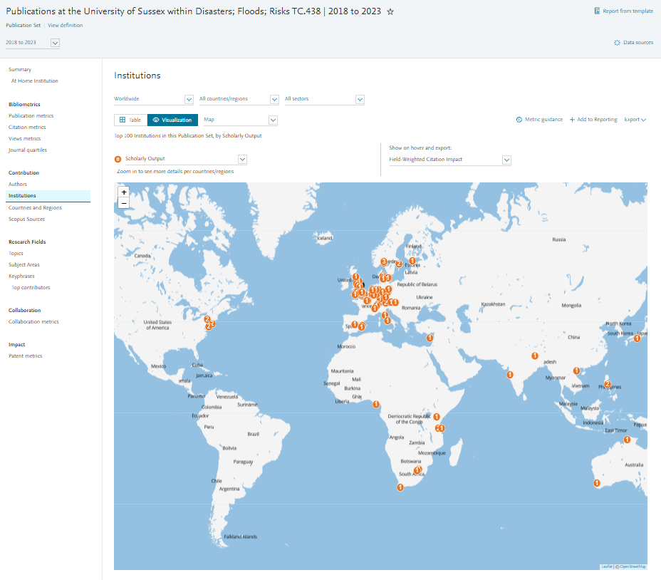
UoSx collaborating institutions:
Publication set as entity - step 2

Slide 25
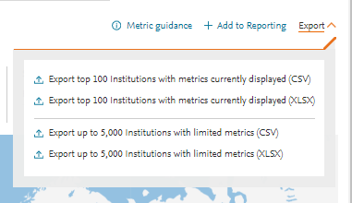
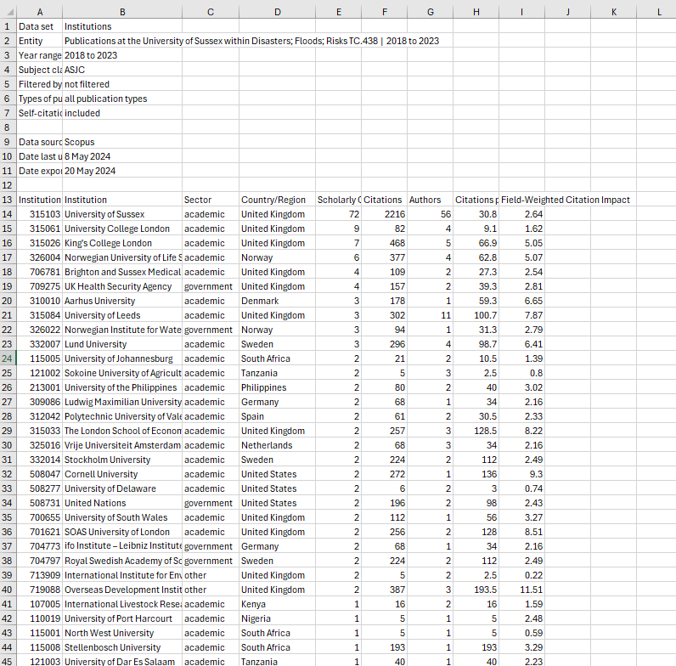
UoSx collaborating institutions:
Publication set as entity - step 2

Slide 26
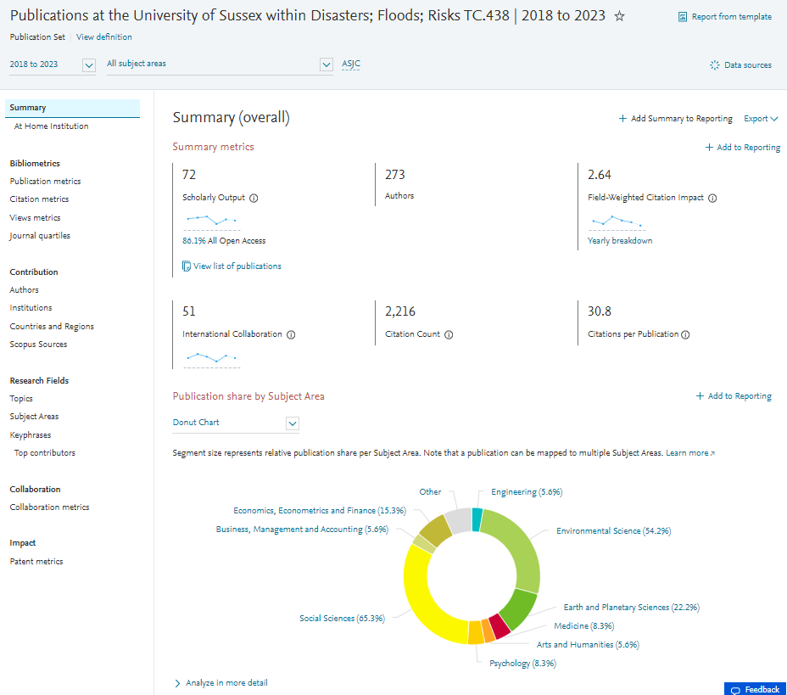
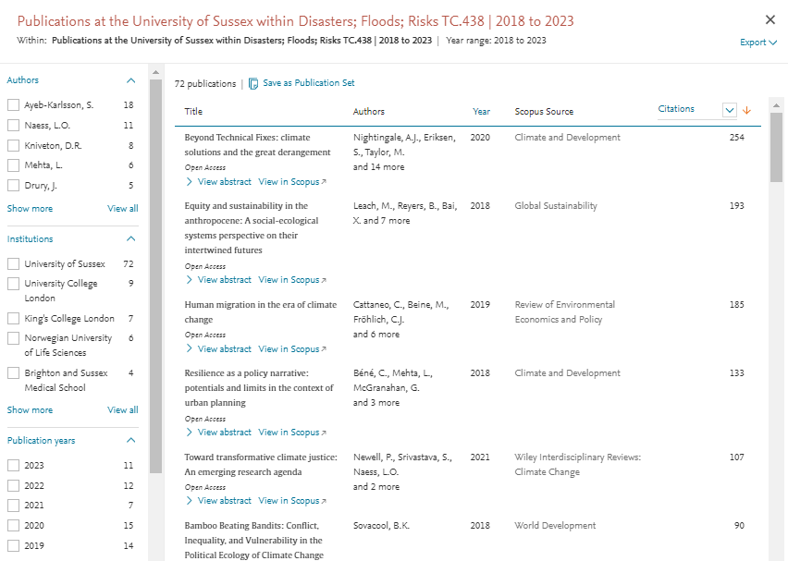
(Exporting publication set)

Slide 27
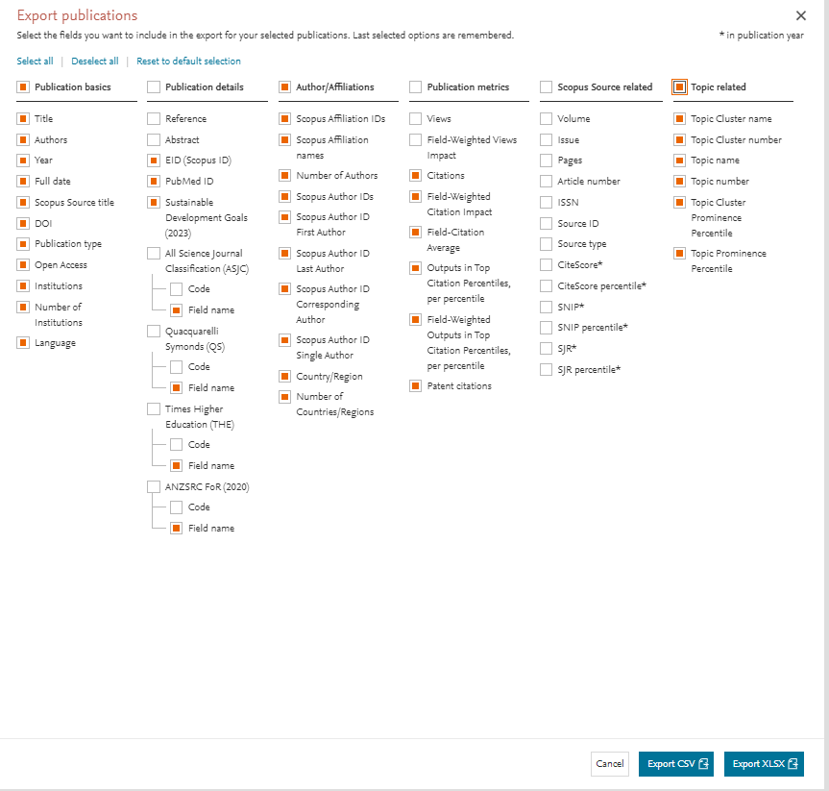
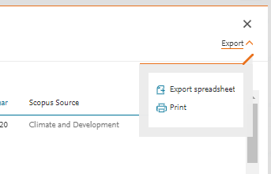
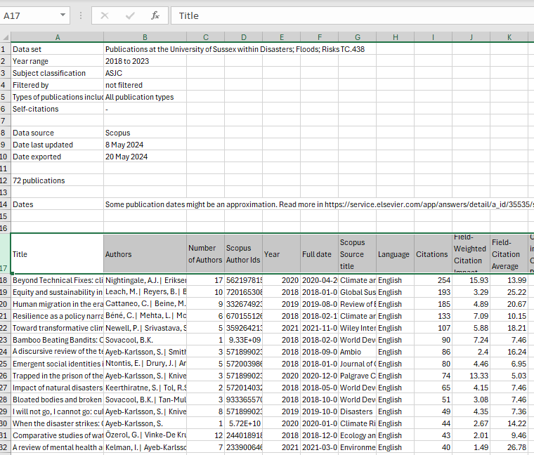
(Exporting publication set)

Slide 28
A case study
The “ask”
The approach
The results
Where we’re at
(Postscript)

Slide 29
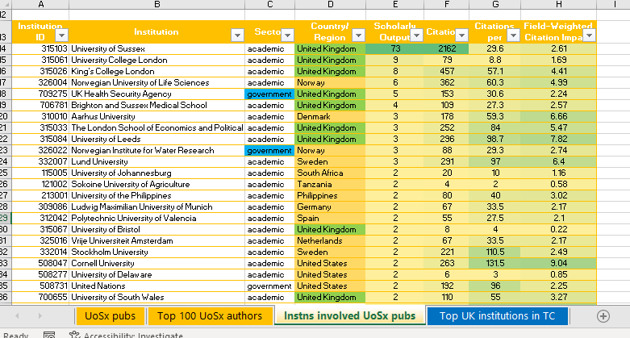



3: The results
14 excel files (1 per T or TC)
- 4 tabs info each

Slide 30

Consolidate UoSx authors
167 unique author IDs
Many authors picked up >1 T / TC
BUT…
  How contact?
  Still at Sx?
  Staff / students?
  Which School / Dept?

Slide 31
Consolidate UoSx authors
School | # can be leads | # other researchers
Eng Inf | 6 | 2
Global | 15 | 3
IDS | 3 | 18
LifeSci | 2 | 1
LPS | 4
MAH | 1
Psychology | 5 | 1
USBS | 20 | 7
VC office | 2
 | 58 | 32
Manual check UoSx data sources:
  Outlook
  UoSx profile page
  Yellow screens
Still @ Sx: 109
  58 Potential leads (by Title)
  32 Other staff / Researchers
  8 Visiting / Mismatch
  11 Student / School Tutor
Left Sx: 58
Potential internal collaborators?

Slide 32
Consolidate UoSx authors
School | # can be leads | # other researchers
Eng Inf | 6 | 2
Global | 15 | 3
IDS | 3 | 18
LifeSci | 2 | 1
LPS | 4
MAH | 1
Psychology | 5 | 1
USBS | 20 | 7
VC office | 2
 | 58 | 32
Manual check UoSx data sources:
  Outlook
  UoSx profile page
  Yellow screens
Still @ Sx: 109
  58 Potential leads (by Title)
  32 Other staff / Researchers
  8 Visiting / Mismatch
  11 Student / School Tutor
Left Sx: 58
Look at Scopus
Possible external collaborators?
UK Uni |  | UK other | Non-UK
Anglia Ruskin | LSE | Company | Australia
Birkbeck | OU | Met office | Austria
Bristol | Oxford Brookes | Other *2 | Canada
Cardiff | Sheffield |  | France *2
City Uni | Southampton |  | Germany *3
Coventry | Sterling |  | Netherlands *2
Greenwich | Warwick |  | Spain *2
Hertfordshire |  |  | Sweden
Liverpool |  |  | Turkey
  24 no info re current location
  34 have published since & have possible location

Slide 33
A case study
The “ask”
The approach
The results
Where we’re at
(Postscript)

Slide 34
4: Where we’re at
Identified 90 staff currently at UoSx might have interest in the call
  Reached out & invited to networking event
If people want to proceed, we have to hand:
Starter network information:
  List of institutions we co-author with in relevant areas
  List of 34 ex-staff / PGRs that might have interest in the call
    16 based in UK HEIs
    4 in other UK institutions
    14 at other institutions around the world
Further network information:
  List of UK institutions publishing in areas of interest
  WW sector information

Slide 35
A case study
The “ask”
The approach
The results
Where we’re at
(Postscript)

Slide 36




5: Postscript
RAs an Entity – pre-populated

Slide 37




5: Postscript
RAs as an Entity – create bespoke part 1
1: Create Definition
3 options to base it on:
Search terms
Entities
Topics

Slide 38



5: Postscript
RAs as an Entity – create bespoke part 2
2: Refine Definition
6 options to use (in combo, any order):
Subject Areas
Scopus Sources
Institutions
Country/Region
Organisation type
Publication years

Slide 39



5: Postscript
RAs as an Entity – create bespoke part 3
3: Save Definition
Can add:
Description
Tags

Slide 40

Ta da!
Questions?
http://www.sussex.ac.uk/staff/research/rqi/resintel
Log in to SciVal

